Slide 1


Unraveling the Enigma: A Captivating Sudoku Solver Visualizer in C++

Slide 2
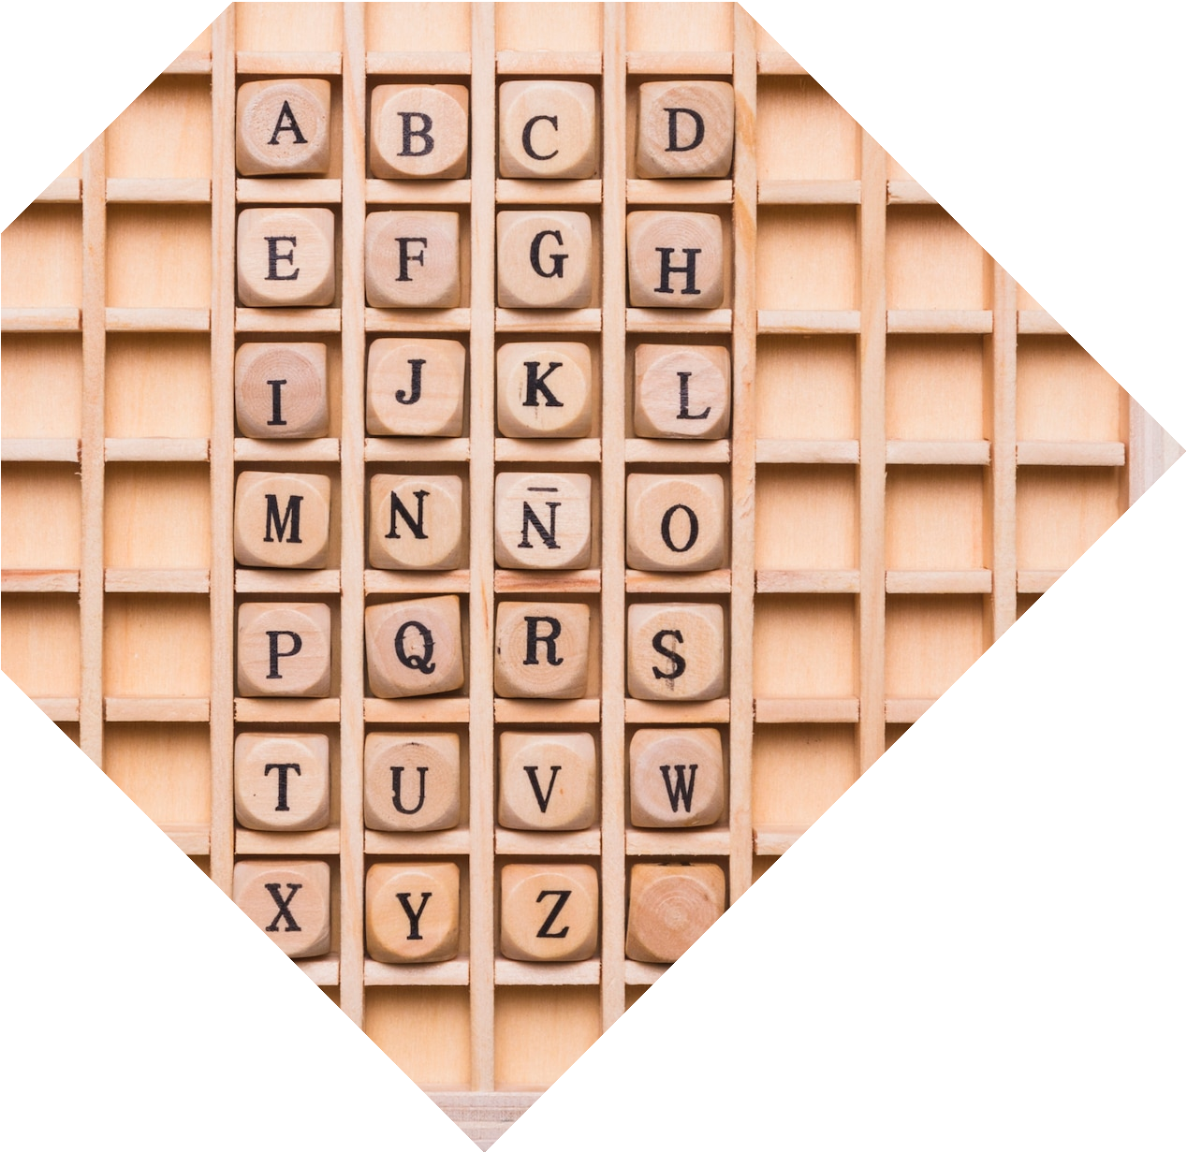







Unveiling the Sudoku Solver
Discover the captivating journey of a C++ Sudoku solver and its visually stunning representation. Explore the intricate algorithms and problem-solving techniques that power this remarkable application.

Slide 3

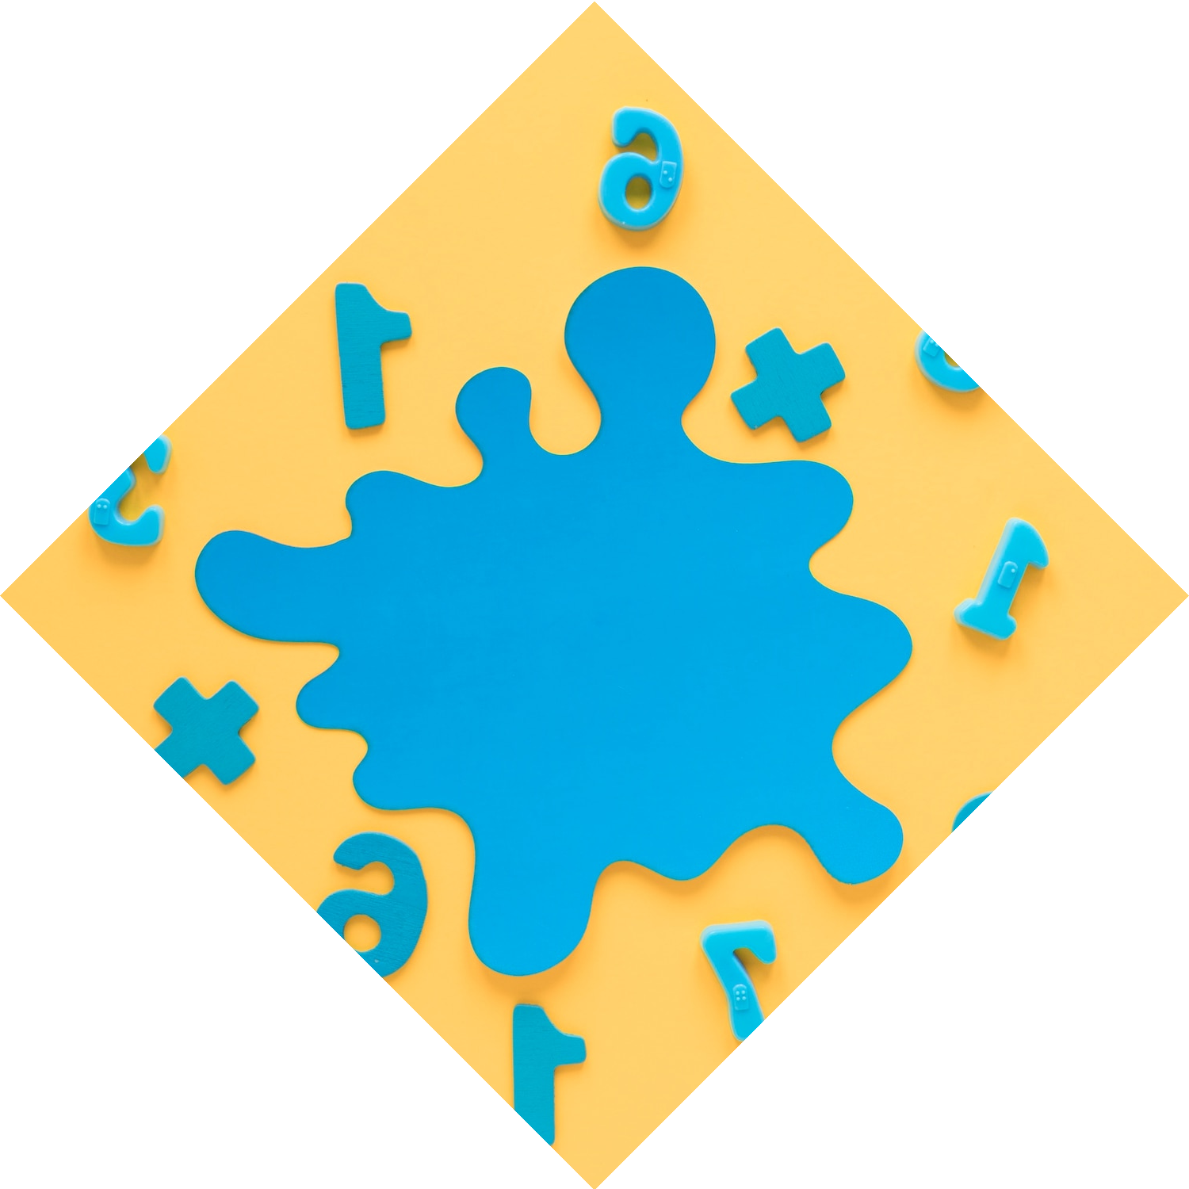


The Enigma of Sudoku
Sudoku, a classic logic-based puzzle, has captivated minds worldwide. Delve into the historical origins and the mathematical principles that underlie this engaging game.

Slide 4
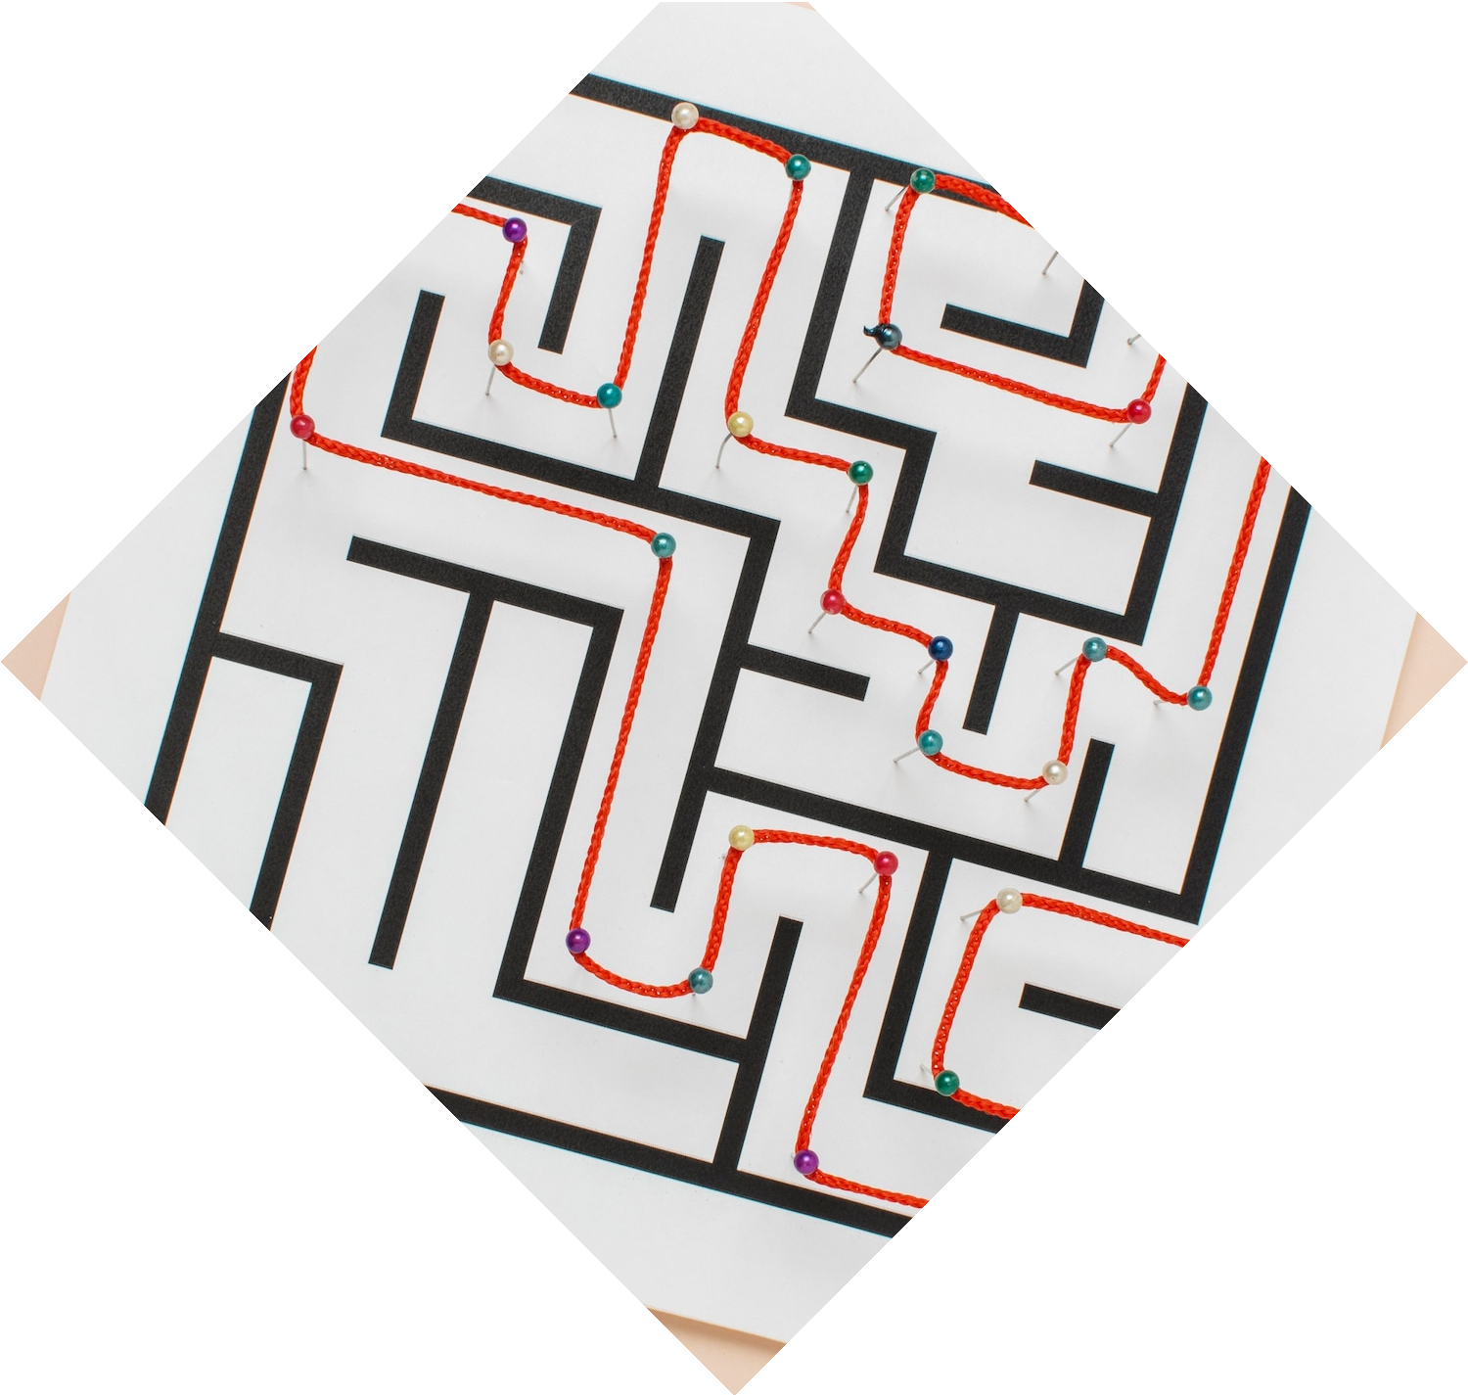






Mastering the Algorithm
Uncover the innovative algorithms employed by the C++ Sudoku solver. Explore the backtracking and constraint propagation techniques that eﬃciently solve even the most challenging Sudoku puzzles.

Slide 5









Visualizing the Solution
Experience the dynamic and visually appealing representation of the Sudoku solver in action. Witness the step-by-step process as the algorithm navigates through the puzzle, revealing the ﬁnal solution.

Slide 6
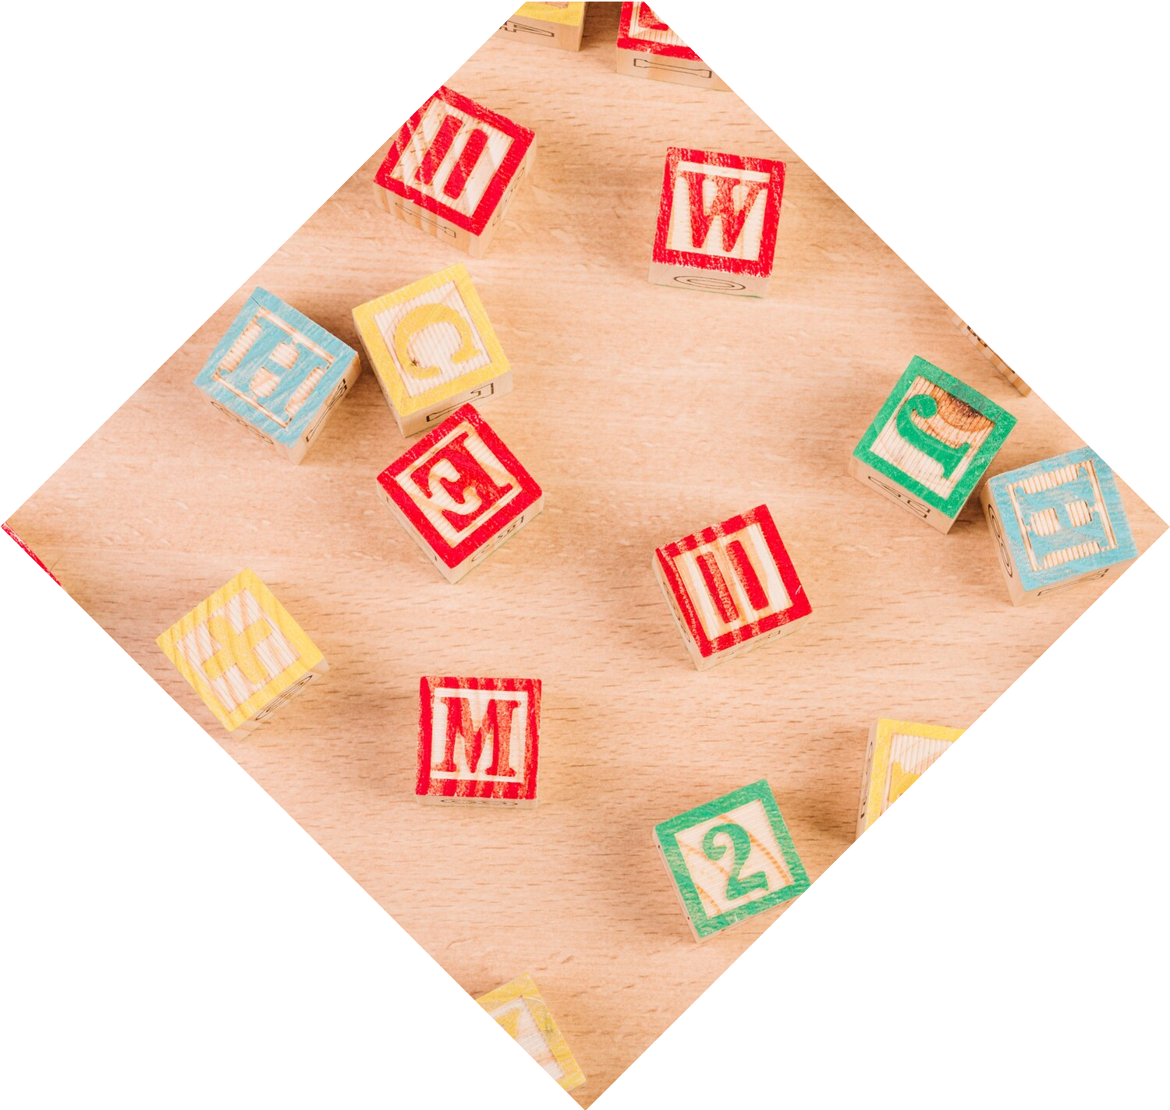










Unlocking the Potential
Delve into the potential applications of the Sudoku solver beyond the classic puzzle.
Explore how this versatile tool can be
adapted to solve other logic-based
problems and enhance various problem- solving domains.

Slide 7
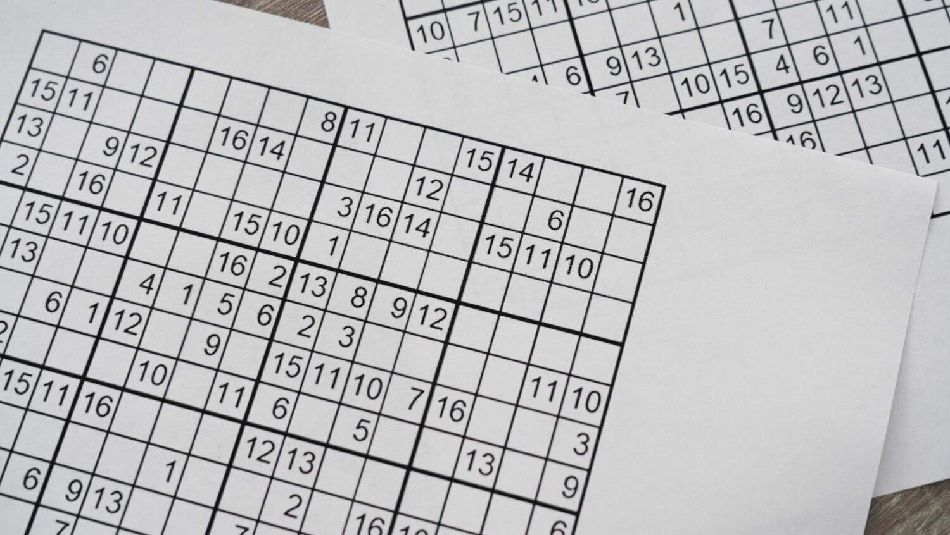










The Art of Optimization
Discover the optimization techniques employed in the Sudoku solver to enhance its performance and eﬃciency. Learn about the trade-oﬀs between speed, memory usage, and solution quality in the algorithm's
design.

Slide 8














Collaborative Possibilities
Explore the potential for collaboration and community involvement in the development and enhancement of the Sudoku solver. Discuss the open-source nature of the project and the opportunities for contributions and
improvements.

Slide 9










The Future of Sudoku Solving
Envision the future of Sudoku solving and the role of the C++ Sudoku solver in this evolving landscape. Discuss the potential for integrating the solver into various applications and exploring the boundaries of problem-solving capabilities.

Slide 10
Thanks!

